Slide 1












FLYING BIRD
Urvi Padelkar Tanvi Mirgal Ayush Mistry Sahil Mujumdar
Project Guide
Ms.
Prof Poonam Pangarkar

Slide 2

1. Introduction
The project is well designing objects.
As well as for carrying out basic graphics functionalities like drawing a simple line, circle, triangle, Oval, arc.
We are implementing Flying Bird with the help of programming codes using graphics.

Slide 3

2. Objectives
To build a user friendly mobile application.
To achieve efficiency.
To understand various functions and commands in graphics.
To study the implementation of various header files.

Slide 4

4. Feature
We have created a flying bird with the help of minimal code.
By using various in-built and predefined functions the coding becomes easier.

Slide 5

3. Built in functions used
Line(): is a library function of graphics.c in c programming language which is used
to draw a line from two coordinates.
Syntax:
line(int x1,int y1,int x2,int y2);
arc(): The header file graphics.h contains this function which draws an arc.
Syntax:
arc(int x, int y, int start_angle, int end_angle, int radius);
circle():
syntax:
circle(int x,int y,int radius);

Slide 6

7.Flow diagram
#include<graphics.h> #include<conio.h> #include<dos.h>
//FOR WINGS
void wingsDown(int i)
{
line(85+i,155,45+i,185); line(85+i,155,115+i,195); arc(90+i,130,228,292,70);
}
void wingsUp(int i)
{
line(85+i,155,125+i,115); line(85+i,155,55+i,118); arc(90+i,177,60,122,70);
}

Slide 7
void main()
{
int gd=DETECT,gm;
initgraph(&gd,&gm,"C:\\"); int i=0;
//FOR BIRDS BODY
for(i=0;i<400;i++)
{
circle(150+i,150,20); arc(90+i,190,50,145,60); arc(87+i,117,220,320,60);
//FOR BEAK line(170+i,147,180+i,153); line(180+i,153,170+i,156);
//FOR EYE
circle(162+i,150,2);

Slide 8
//FOR TAIL
line(10+i,155,40+i,155); line(10+i,145,40+i,155); line(10+i,165,40+i,155);
//FOR MOVING WINGS if(i%2==0) wingsUp(i);
else wingsDown(i); delay(100); cleardevice();
}
getch();
closegraph();
}

Slide 9

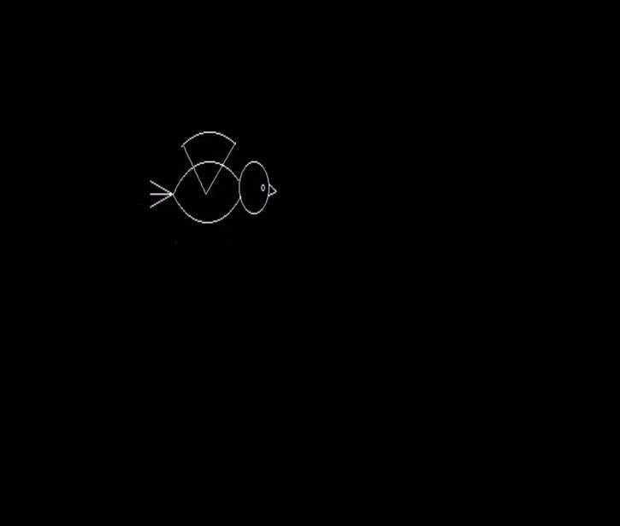
5. Output of Project

Slide 10
Thank You...!!

